Slide 1

B18 Lesson 4
Bishop Stopford School
faith | justice | responsibility | truth | compassion
ONLINE LEARNING
Learning Objectives
Retrieval
Acquire
Action
Review
Dig Deeper

Slide 2
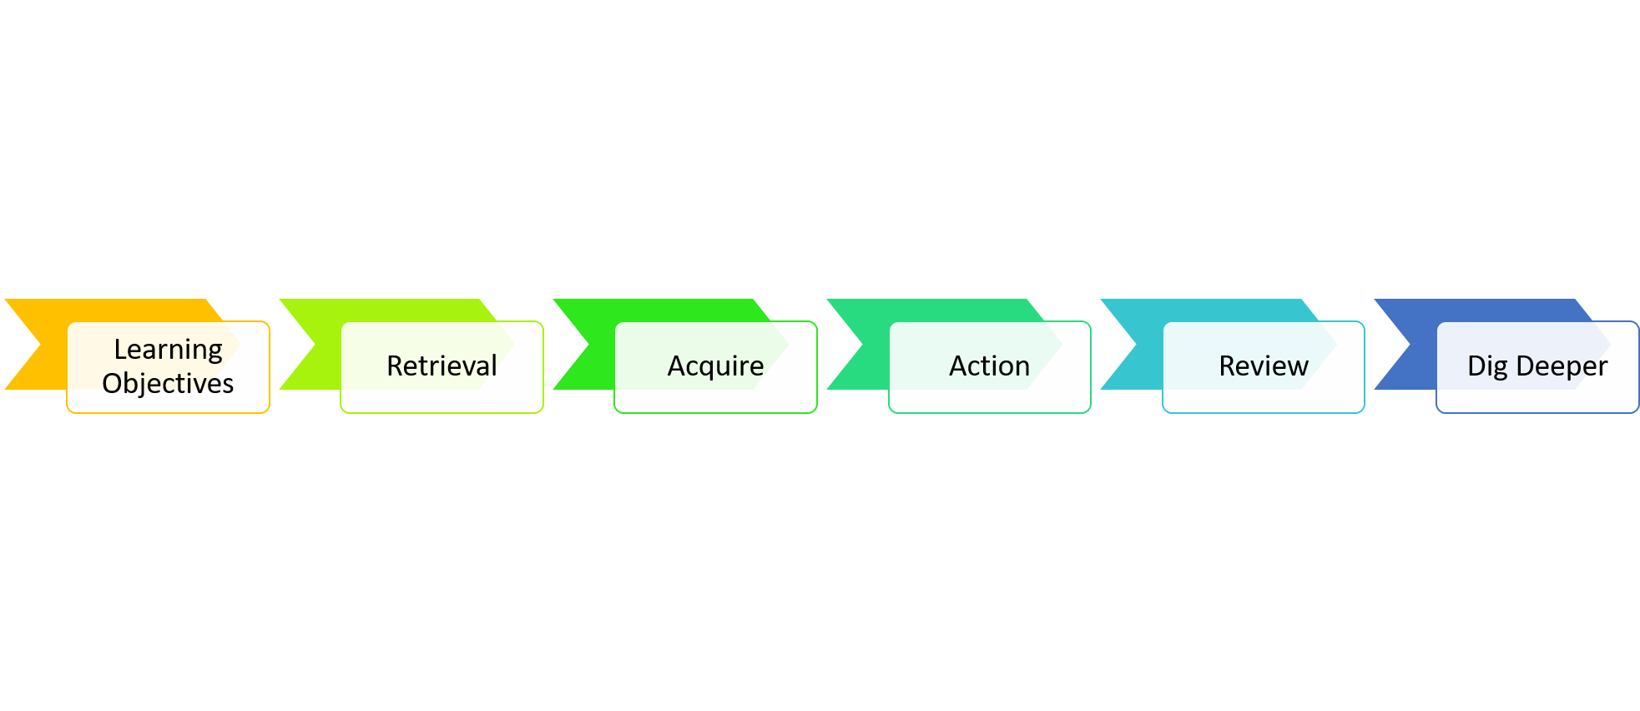
Biodiversity
Learning Objectives
1)State what biodiversity is
2)Describe how humans impact biodiversity
3)Explain how we can reduce our negative impact on biodiversity

Slide 3
Starter
1) State 1 way humans can pollute water
2) State 2 greenhouse gasses
3) State 3 fossil fuels
4) State 4 issues with global warming

Slide 4


Watch Video 1
You can watch this video as many times as you want to

Slide 5
Watch Video 2

Slide 6
Watch Video 3

Slide 7
Key Notes/Task
Use the videos you have just watched alongside your revision guide or the online kerboodle text book to create a public awareness leaflet or poster on biodiversity.
Your leaflet should:
-State what biodiversity is
-Describe how humans impact biodiversity
-Explain how we can reduce our negative impact on biodiversity
-Be well presented so that the public would want to read it

Slide 8

Review
RAG (red, amber, green) the learning objectives to show how confident you are with them

Slide 9
Dig deeper (optional)
Some scientists say we’re in the midst of Earth’s sixth mass-extinction event, caused entirely by us. But some animals have a knack for surviving in a human-dominated world. What’s their secret? Watch the video on the next slide Chose one of the animals mentioned and explain in your own words what it's 'secret for surviving' is. If you want to do more than one animal...go for it :-)

